Slide 1

Prediction of Flight Cancellation
CSCI-B565
Data Mining
Course Instructor - Yuzhen Ye
Project Team Members:
Ratan Tejaswi Vadapalli(ravadap@iu.edu)
University ID:2001023546
Durga Sindhu Animalla (duanim@iu.edu)
University ID:2000996628

Slide 2
Contents
Introduction
Conclusion
Classification algorithms
Problem Statement
Approach to the problem
Data preprocessing techniques used

Slide 3

Introduction
Dataset
Dataset Details
Total Rows: 6,311,871
Platforms
Python
The data was collected from this Kaggle website Flight Status Prediction 2021
Total Attributes/Columns: 61
Size of the data: 2.21 GB
Short description of the dataset
This data is managed by Bureau of Transportation Statistics , U.S Department of Transportation
The dataset consists of flight information including cancellations and delays categorized by airlines

Slide 4
APPROACH TO THE PROBLEM
Input Data
Data preprocessing
Prediction
Data Cleaning
Data Classification
Interpretation/Visualization
EDA

Slide 5
PROBLEM STATEMENT
Passengers seem to go through a lot of annoyance after getting to know that their flights have been cancelled in the last minute. This causes them to get stranded in the airports ,wastes their time and money.
Predicting cancellations beforehand will allow the airline to provide a better customer experience and also helps the passenger to make changes in their plans.
This allows airlines to save operating costs.

Slide 6
Observations after EDA
Some problematic attributes resulting in easy decision making
Null values found in the records
Imbalanced class distribution observed in the target variable
Some months and some airports have higher flight cancellations
Attributes like weather and passenger count would have resulted in a better model
Data in some attributes require modifications like integer encoding

Slide 7
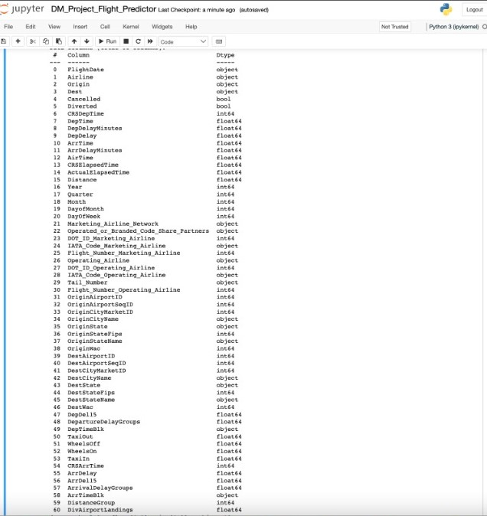
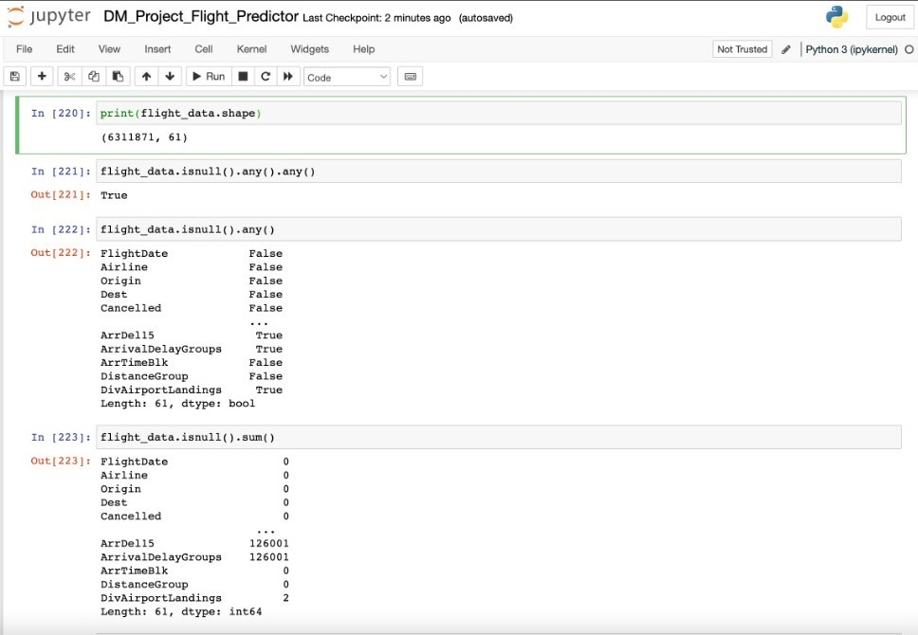

Slide 8
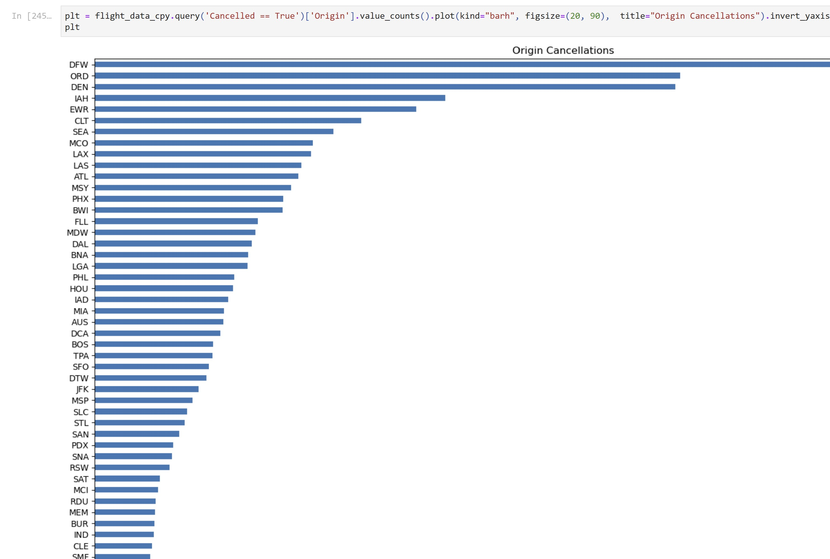
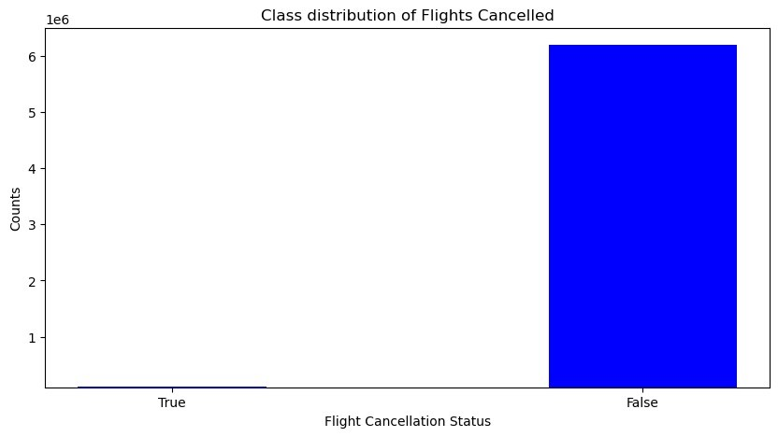
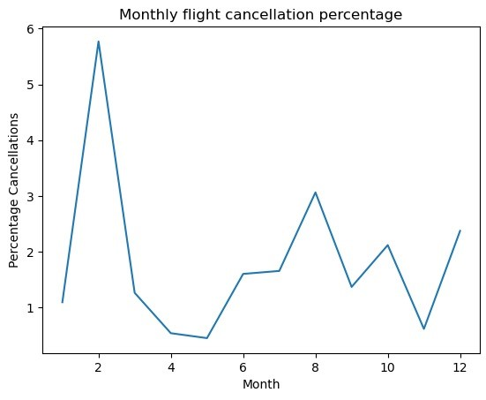

Slide 9
Data Pre-processing
Handling missing data
Null values in columns have been replaced with the mode of the column
Feature selection
Some attributes have been dropped
Data transformation
Integer encoding has been applied on some attributes to convert them into usable data
Sampling techniques
Sampling techniques like SMOTE, random under sampler and ADASYN have been applied

Slide 10
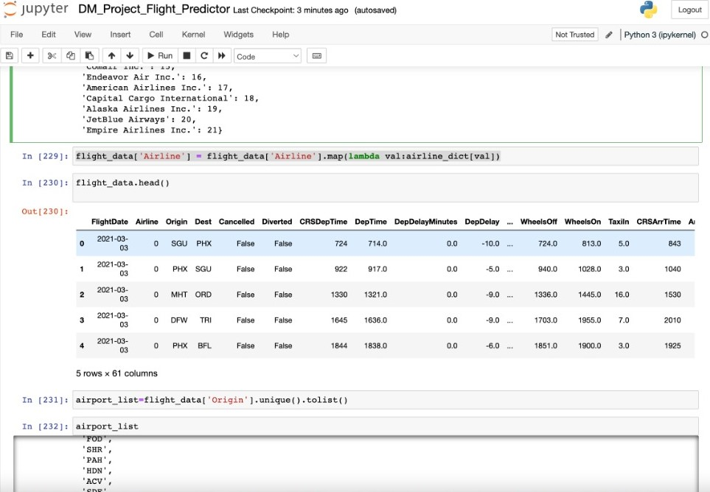
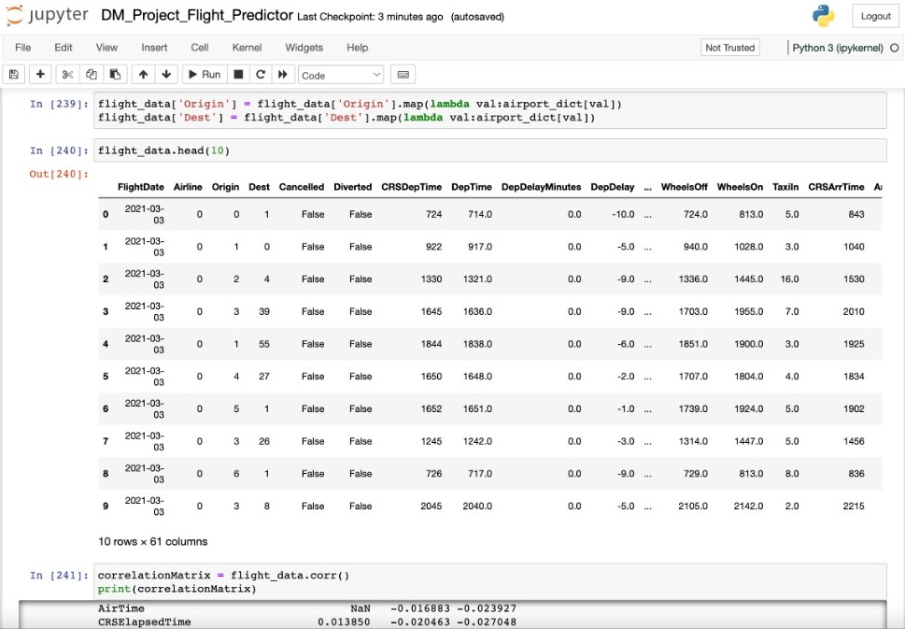

Slide 11
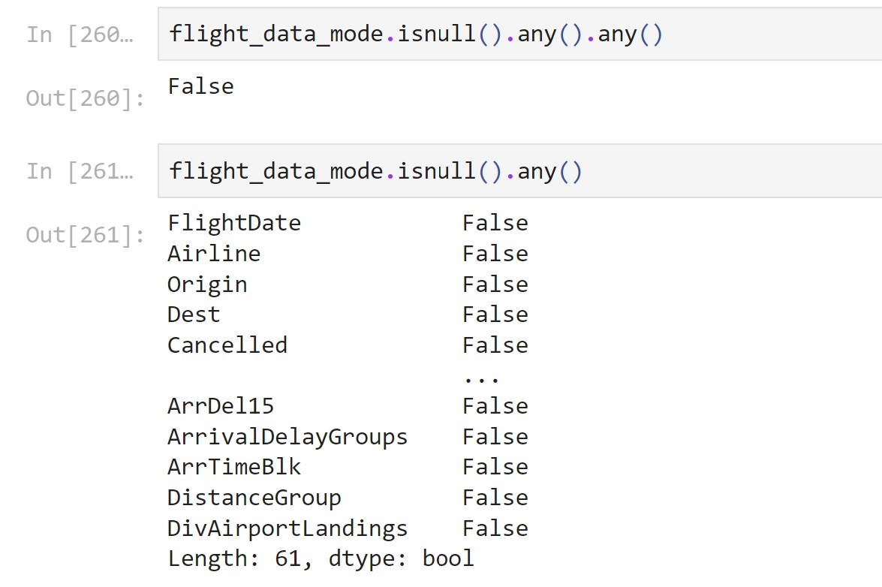
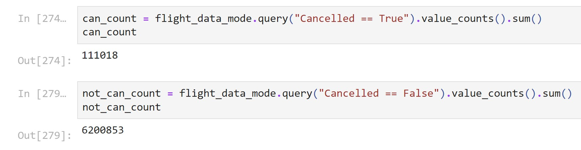
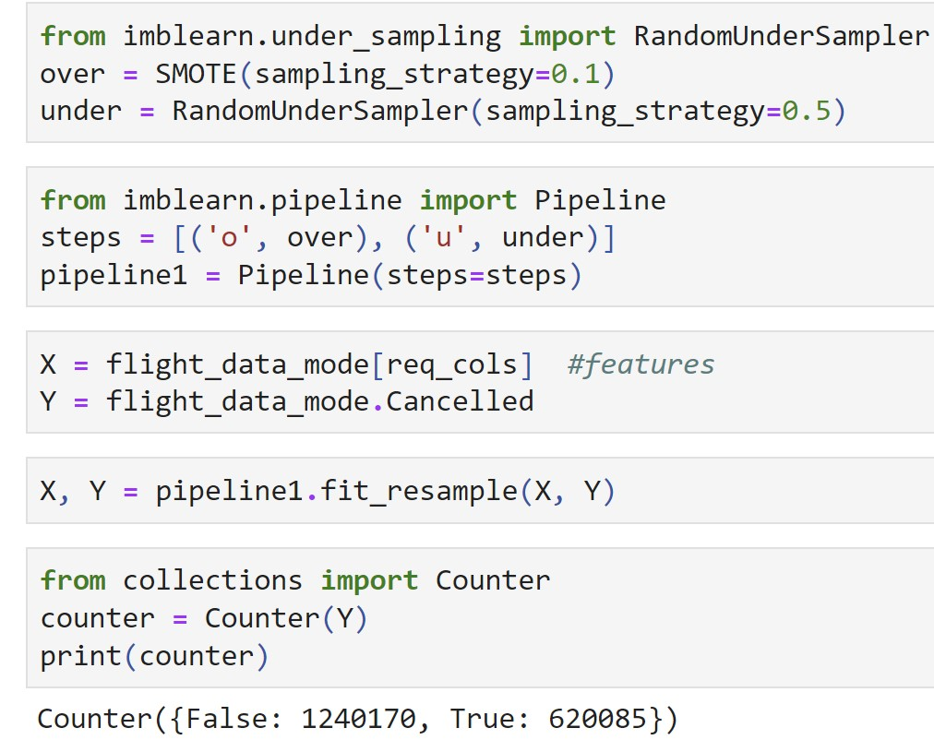
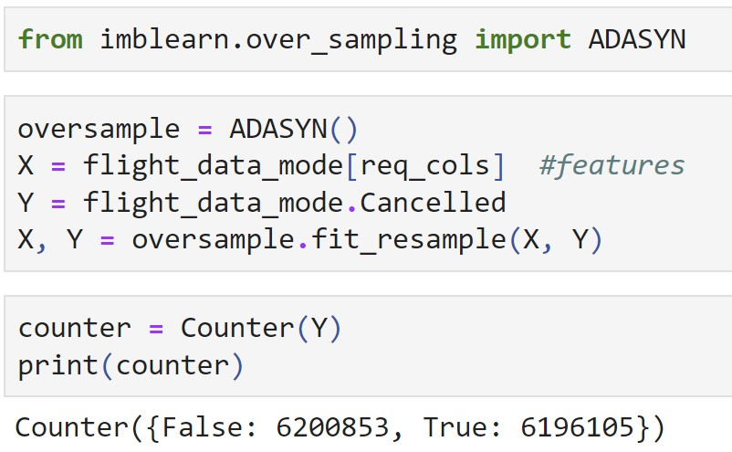
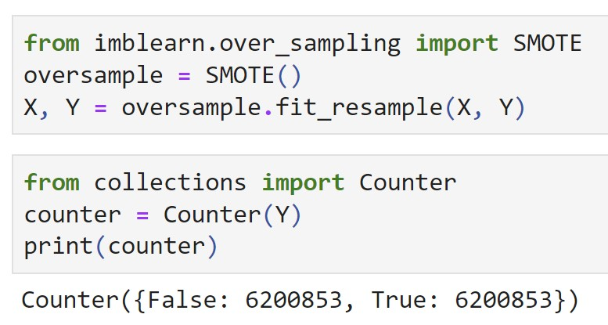
Counts for cancelled flights and not cancelled flights
Class distribution after performing SMOTE
Class distribution after applying
Random under sampling along with SMOTE
Class distribution after applying
ADASYN

Slide 12
Classification Methods Used
Decision tree classifier using entropy as criterion
Bagging Classifier
ADABOOST Classifier

Slide 13
Techniques Applied
Model with imbalanced data
Model with oversampling after applying SMOTE
Model with oversampling after applying SMOTE and undersampling using Random Under Sampler Model with oversampling after applying ADASYN

Slide 14
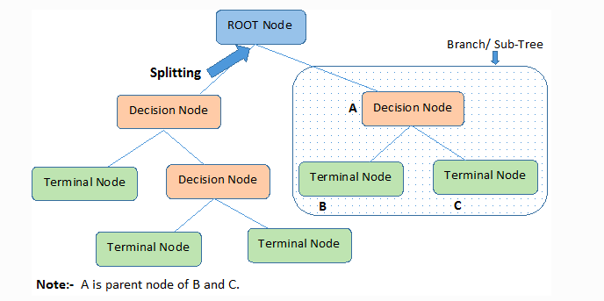
Decision tree
Decision Tree algorithm belongs to the family of supervised learning algorithms.
The goal of using a Decision Tree is to create a training model that can use to predict the class or value of the target variable by learning simple decision rules inferred from prior data(training data).

Slide 15
Decision tree
Separating features and target attribute
Dividing train and test sets
Building the decision tree using train set
Checking the accuracy of the model built using test set

Slide 16
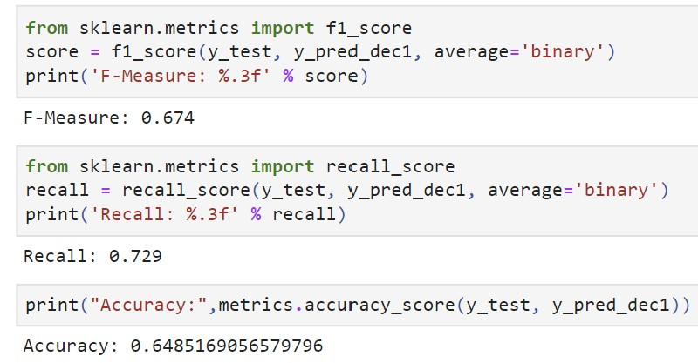
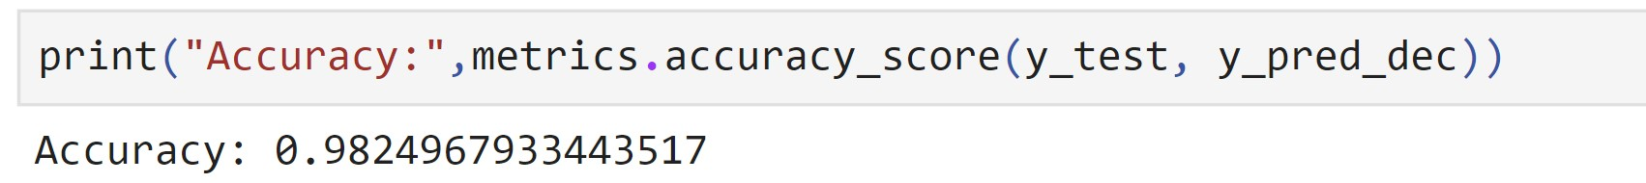
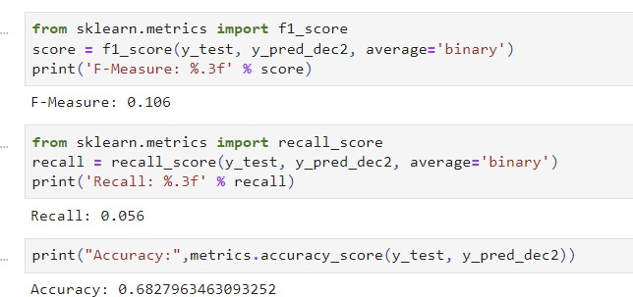
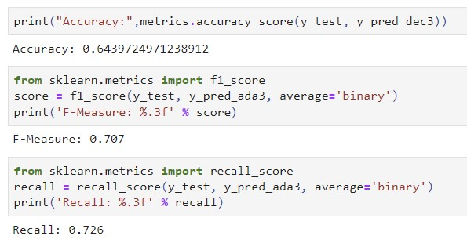
Original Data Results
SMOTE Results
SMOTE and RUS Results
ADASYN Results

Slide 17
BAGGING CLASSIFIER
Bagging Classifier is an ensemble meta-estimator.
Decision Tree as base classifier.

Slide 18
BAGGING CLASSIFIER
Separating features and target attribute
Dividing train and test sets
Fitting the model using train data
Predicting the test set
Checking the accuracy of the model built using the prediction made

Slide 19
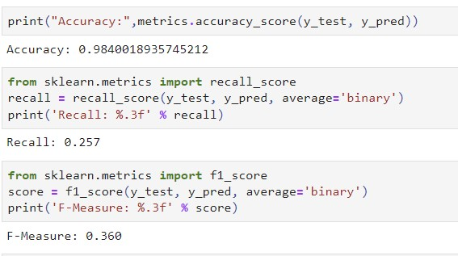
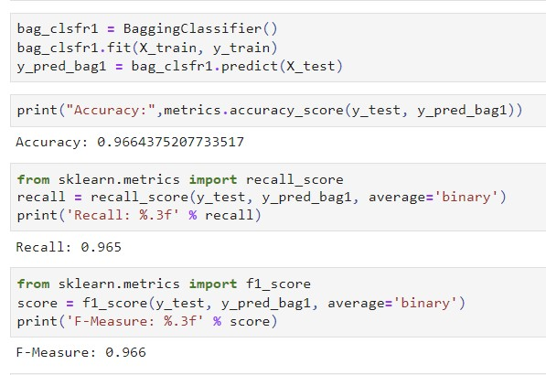
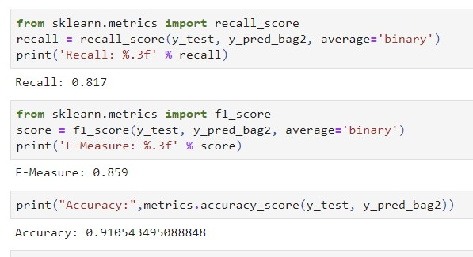
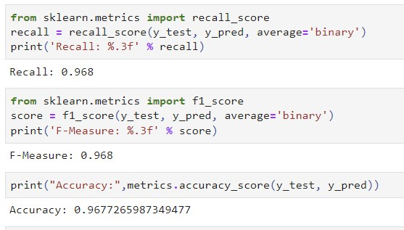
Original Data Results
SMOTE Results
SMOTE and RUS Results
ADASYN Results

Slide 20
ADABOOST CLASSIFIER
Non-parametric supervised learning method used for classification.
Decision Tree as base classifier.

Slide 21
ADABOOST CLASSIFIER
Separating features and target attribute
Dividing train and test sets
Fitting the model using train data
Predicting the test set
Checking the accuracy of the model built using the prediction made

Slide 22
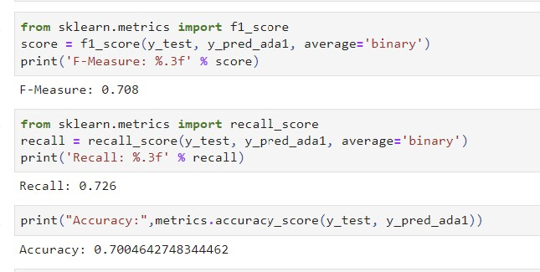

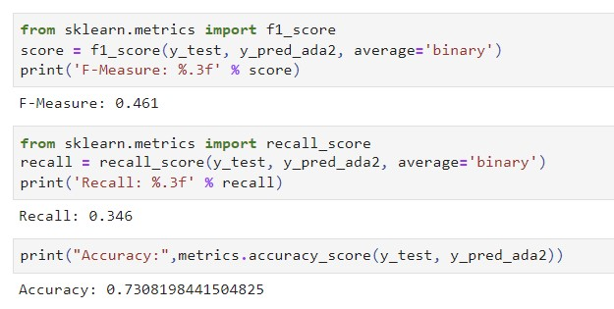
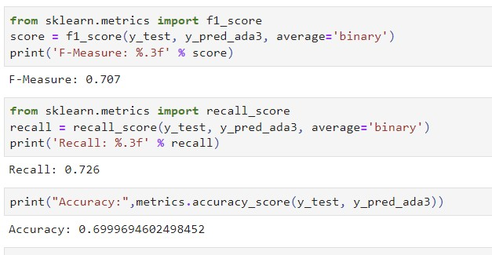
Original Data Results
SMOTE Results
SMOTE and RUS Results
ADASYN Results

Slide 23
FUTURE ENHANCEMENTS
Can try using Random Forest to check if overfitting is better reduced.
Try if using clustering will improve the prediction.
Attributes like weather data and passenger booking count will highly improve model.

Slide 24
Conclusion
Accuracy comparison
Decision tree was overfitting with original data and since records with cancelled flights is small, wrong predictions would not make a big change in accuracy.
After sampling the data, decision tree showed similar accuracies on all sampling techniques.
ADABOOST Classifier seemed to produce around 70% accuracy consistently after sampling and looks like it reduced overfitting.
Bagging Classifier seemed to produce a consistently higher recall values which is necessary in output sensitive applications.

Slide 25

Conclusion
Attributes Influencing Models
Looks like month of flight, origin and destination, quarter are most influencing factors for flight cancellations.

Slide 26

THANK YOU

